Slide 1

SQL Security Principals and Permissions 101
A ground-floor introduction to SQL Server authentication, security principals, and the database object permission model.
William Assaf, MCSE

Slide 2
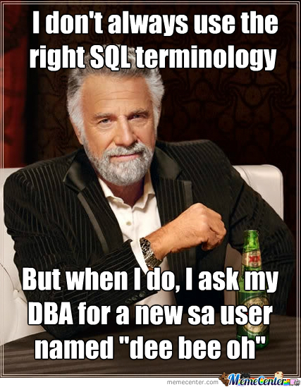
Why THIS topic?
This is a ground-floor introduction for anyone who interacts with SQL Server.
SQL Admins and Developers
Business Intelligence Developers
.NET Developers
Sysadmins

Slide 3
Why is this important?
Proper implementation of SQL Server security principals:
Decreases administrative effort
Decreases application complexity
Decreases database surface area
Listen during this presentation for real-world applications of this knowledge, and feel free to ask questions or chime in

Slide 4
Important acronyms
PEBKAC
PICNIC
ID-10-T
Problem Exists Between Keyboard and Chair
Problem in Chair, Not in Computer
Did you know that 90% of Security incidents are still caused by PEBKAC, PICNIC and ID-10-T errors?

Slide 5
Login vs user
Database User
Set a database context
Linked to a Server Login
Does not have a password
Assigned to Database Roles
Stored in the User Database
Brought along with a User DB Restore
Given access to SELECT, UPDATE, EXECUTE, CREATE TABLE
Server Login
Connect to a SQL Server
Can be linked to AD (Windows)
Can have a password (SQL)
Assigned to Server Roles
Stored in the Master database
Not affected by User DB Restore
Given access to RESTORE, CONNECT, CREATE DATABASE

Slide 6
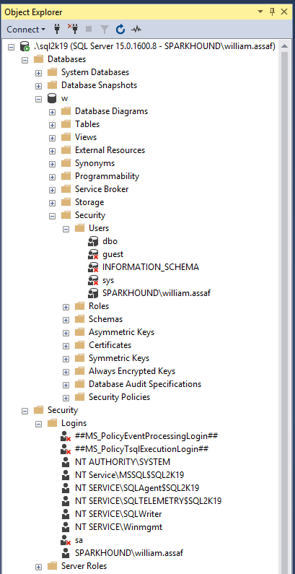
Database User
Set a database context
Linked to a Server Login
Does not have a password
Assigned to Database Roles
Stored in the User Database
Brought along with a User DB Restore
Given access to SELECT, ALTER, EXECUTE, CREATE TABLE
Server Login
Connect to a SQL Server
Can be linked to AD (Windows Login)
Can have a password (SQL Login)
Assigned to Server Roles
Stored in the Master database
Not affected by User DB Restore
Given access to BACKUP, RESTORE, CONNECT, CREATE DATABASE

Slide 7
On the topic of Groups…
Always assign permissions to AD groups, insist on it.
BUT
Be aware of who is a member of those groups, and what groups are a member of those groups you’re granting access to, and what groups are a member of those groups, and what groups are a member of those groups…
Devs -> App Support -> QA -> Financial Analysts…

Slide 8
On the topic of Groups…
You can interrogate AD for the members of security groups
EXEC master..xp_logininfo
@acctname = 'domain\groupname',
@option = 'members'
BUT
It only returns FIRST level members, not members of groups that are members of the group. Instead use PowerShell, for example:
Get-ADGroupMember -identity 'Development' -recursive

Slide 9
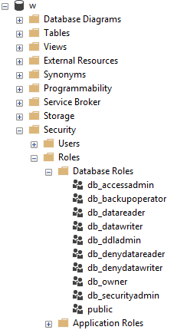
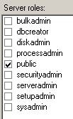
Roles
Roles are security principals that can grant permissions to other security principals.
Logins are added to Server Roles
Users are added to Database Roles
Built-in Roles to provide a standard for access.
Assign more specific permissions when possible.
Every login is a member of public.

Slide 10
Logins
A SQL Server Login is a server-level security principal
A User is a database-level principal
Logins are given a default database.
CONNECT will fail if the Default Database is not accessible.
Best practice- set Default Database to the intended User Database, or to TempDB, which is always there, but not persistent.

Slide 11
Logins vs users
Remember, a Server Login is what authenticates a user connection to the SQL Instance.
A Database User provides a Login with database access.
“Login” is a server level security principal.
“User” is a database level security principal.

Slide 12

Sql logins
SQL Logins are authenticated by SQL Server.
Strongly encouraged to Enforce password policy, which can include password expiration, inheriting from the same settings in Windows.
Unfortunately, the password policy is optional!
Multiple failed SQL auth login attempts will Lock Out, which a DBA must resolve.

Slide 13
Windows vs SQL Auth
Remember, a Login is what authenticates the user to the SQL Server instance, not a User.
In a typical business environment,
Windows Authentication means that
account creation/termination,
security group membership,
password policy,
are handled by an existing corporate security administration infrastructure.

Slide 14
Windows vs SQL Auth
Windows Authentication is the default security model for SQL Server, by default the only security model, and cannot be disabled.
The Windows Authentication model creates Server Logins that are linked to Local Windows or Domain Accounts
Preferably linked to AD Security Groups, not individuals, so this membership is also managed by your existing security infrastructure.
Choosing Mixed Mode as a server option enables SQL Logins and allows the “sa” account to be enabled.

Slide 15
Apps + windows auth
From an Internet-facing server, Kerberos may be required to authenticate a Windows User directly from the application server to the SQL Server.
Can increase the complexity of an application loadout, but this is the Enterprise approach.

Slide 16
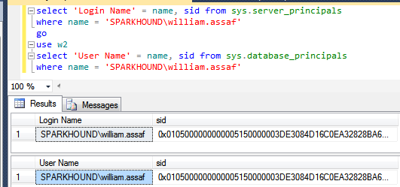
users
A User can be linked to any Server Login – the names don’t actually have to match.
Users have a sid (SID (Security-IDentifier) which is shared by the linked Login.

Slide 17
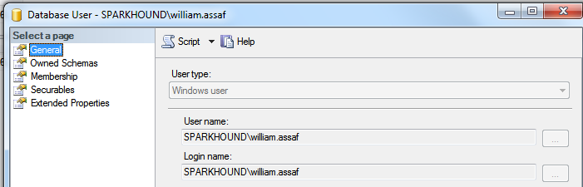
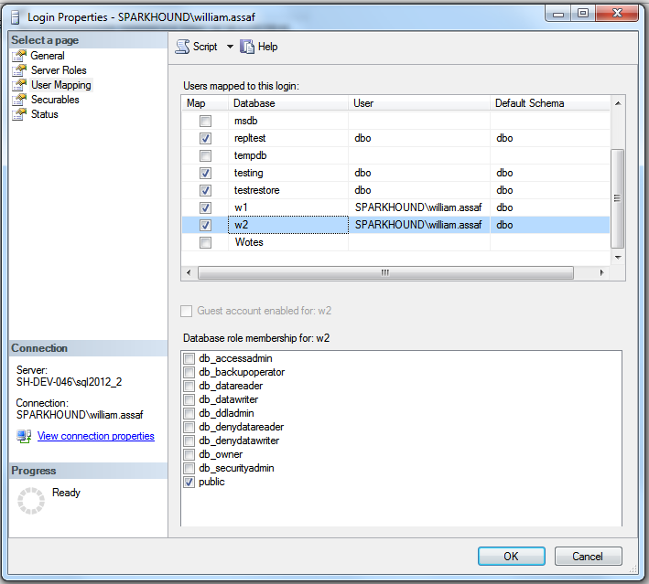
users
Logins are mapped to Users in the User Mapping page of the Login properties dialog.
The mapping can be verified on the General page of the User properties dialog.

Slide 18
Orphaned sid
SQL Auth Logins can become disconnected from their Database Users when a database is restored from another server.
Only occurs with SQL Authenticated Logins, not Windows Authenticated Logins
Commonly occurs when a database is restored from one server to another
To re-associate a database user to a server login:
ALTER USER username WITH LOGIN = loginname;

Slide 19
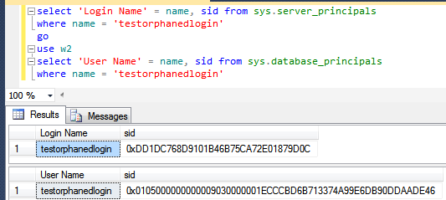
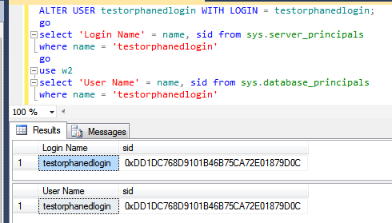
Fix orphaned sid
Fix: SQL Auth Login becomes disconnected from its Database User

Slide 20
Fix orphaned sid
Fix: SQL Auth Login becomes disconnected from its Database User
Toolbox: fix orphaned sid.sql

Slide 21
Sql login migration
It is not possible to reverse-engineer a SQL Authenticated Login’s password.
When migration applications from one SQL Server instance to another, migration of SQL Logins is accomplished by:
Backup+restore of the master database (complicated) -OR-
Creating SQL Logins with same SID but new password (not desirable) -OR-
Generating a hash of the password and same SID (most desirable) Let’s go more into that….

Slide 22
Sql login migration
Microsoft has provided a pair of sprocs to generate a hash of login passwords, without seeing the password.
http://support.microsoft.com/kb/918992
sp_hexadecimal and sp_help_revlogin
But don’t forget to migrate the server-level permissions:
Toolbox: security Script servers.sql
Toolbox: security Script databases.sql
Also recommend DBATools.io for PowerShell scripts for server migration of server-level security, aid with easy migrations, and much more.

Slide 23
Sql login SIDS
Creation of the SQL Login with its existing password AND SID is critical.
This is also important for setting up new Availability Groups, as the Logins need to match the database on every replica.
A regular proactive check for all SQL Server instances in Availability Groups:
Check that all SQL Logins exist
AND they have the same SID, not just same NAME

Slide 24
Contained databases
Not very common architecture but notable.
Moves authentication from the Server level directly to the Database level.
A contained database owner, for example an Application owner, has full control over security in the database.
No server-level (or sysadmin) permissions necessary to administer a Contained Database.
Contained database has no configuration dependencies on the instance, it can be easily moved to another instance.

Slide 25
Contained databases
What this means is that this syntax on a contained database,
which heretofore made no sense, is perfectly valid:
USE [SomeUserDatabase];
CREATE USER BI_User WITH PASSWORD ='strongpassword';

Slide 26
Contained databases
In SQL Server, Authentication can be made with Windows Auth logins or Contained Database Users where the password is maintained in the database.
Agent jobs, system error messages, linked server information, and system settings are all inside the contained database instead of master or msdb.

Slide 27
Contained databases
In fact, Contained Databases will reportedly be the core of a new feature that allows for Availability Groups in SQL 2019 to replicate security.
If the login exists in the database, it can be easily added to a secondary replica without needing to create and maintain the same SQL Login on each replica.
No need for regular checks to make sure SQL Logins have same SID on each replica.

Slide 28
Contained databases
A database platform where all the major necessities for authentication and system objects are stored in the user database…
No system databases needed, so the database is easily portable between servers…
What does this sound like?

Slide 29
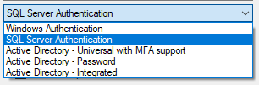
Azure SQL DB
Additional types of authentication since SSMS 2016
All used for Azure Active Directory only

Slide 30
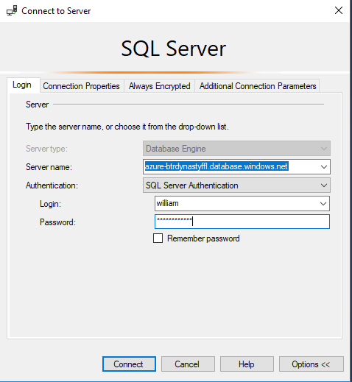
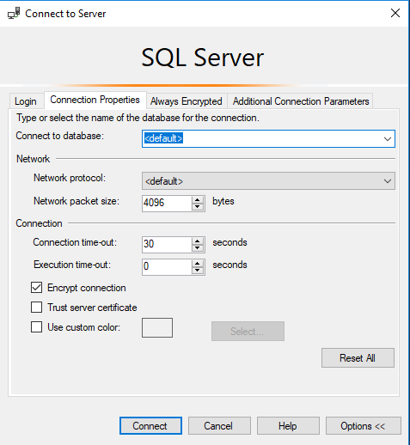
Azure SQL DB
Only real caveat when connecting to an Azure SQL DB:
You youths cannot use USE, you must set the database context at login.

Slide 31
Azure SQL DB
You can use Azure Active Directory accounts only for Azure SQL contained database users, but not for Azure SQL server logins.
Example: in [SomeUserDatabase]
CREATE USER [reportuser@domainname.onmicrosoft.com] FROM EXTERNAL PROVIDER;
Only Active Directory accounts can create other Active Directory accounts in Azure SQL Database.

Slide 32
Azure SQL DB
Otherwise,
Most (not all) permissions, objects, schema operate the same on Azure SQL Database, Azure SQL Managed Instance (MI), and SQL Server.
In this presentation when we’re talking about permissions, stored procs, views, functions, it’s the same for either platform.

Slide 33
Connection providers
OLEDB has been un-deprecated via the new MSOLEDBSQL provider released in 2018.
Convert your OLEDB connection strings from sqlncli11 or sqloledb, to msoledbsql
There is also a relatively new ODBC Driver 17 for SQL Server provider being actively updated.
Both replace the OLEDB/ODBC functionality of the SQL Native Client (SNAC), no longer maintained.
Either the new OLEDB or ODBC can be used to connect to Azure SQL DB, Azure SQL DW.

Slide 34
Basic user permissions
DML*
SELECT
DELETE
UPDATE
INSERT
REFERENCES
*Data Manipulation Language
DDL*
ALTER
CONTROL
VIEW DEFINITION
CREATE
DROP
EXECUTE
*Data Definition Language
Modify Security
GRANT
REVOKE
DENY
IMPERSONATE

Slide 35
Basic permissions
Commonly requested permissions for non-sysadmins
ALTER TRACE For SQL Profiler and traces.
ALTER ANY EVENT SESSION For XEvents
VIEW SERVER STATE For server-level DMV’s, XEvents
VIEW DATABASE STATE For database-level DMV’s
VIEW ANY DEFINITION For definitions of objects, but no data
These permissions are given by the GRANT syntax
GRANT VIEW SERVER STATE TO [SPARKHOUND\william.assaf];
_________________________________________________________________
GRANT VIEW SERVER STATE TO [SPARKHOUND\DBATeam];

Slide 36
Basic user permissions
Example Scenario:
GRANT SELECT ON game.PingPongScores TO [PINGPONG\FGump];
GRANT EXECUTE ON game.spGetPingPongScore TO [PINGPONG\FGump];
GRANT EXECUTE TO [PINGPONG\FGump]; --in current database context
GRANT VIEW DEFINITION ON game.spGetPingPongScore TO [PINGPONG\FGump];
GRANT ALTER ANY EVENT SESSION TO [PINGPONG\FGump];
GRANT VIEW SERVER STATE TO [PINGPONG\FGump];

Slide 37
MORE USEFUL permissions
More useful Server permissions:
GRANT SHOWPLAN Viewing execution plan for executable query
CONNECT ALL DATABASES Grants CONNECT in all current/future db’s
SELECT ALL USER SECURABLES SELECT from all objects in ALL databases, potentially appropriate for day-to-day read-only access for administrators
Less useful Server permissions:
CONTROL SERVER Effective the same as sysadmin. Not for non-admins.*
CONTROL DATABASE Effective the same as db_owner. Not for non-admins.*
*One minor difference. CONTROL permissions can be affected by DENY, but sysadmin/db_owner cannot. Let’s demonstrate…

Slide 38
Testing Permissions with EXECUTE AS
USE Master;
CREATE LOGIN [domain\username] FROM WINDOWS;
GO
GRANT CONTROL SERVER TO [domain\username];
DENY VIEW SERVER STATE TO [domain\username];
GO
EXECUTE AS LOGIN = 'domain\username';
SELECT * FROM sys.dm_exec_cached_plans; --Fails
GO
REVERT; --Reverts the EXECUTE AS
GO
While the sysadmin role is unaffected by any DENY permissions while the CONTROL SERVER permission is. CONTROL SERVER is needed to access sys.dm_exec_cached_plans, a server-level DMV for reviewing plans in cache.

Slide 39
Testing Permissions with EXECUTE AS
EXECUTE AS makes it possible for you to simulate the permissions of another principal in your current session.
Be sure to always follow an EXECUTE AS with a REVERT, which stops the impersonation and restores your own permissions. Each execution of REVERT affects only one EXECUTE AS.
If you run into issues, you can always find out what principal you are running by using this statement:
SELECT ORIGINAL_LOGIN(), CURRENT_USER;
ORIGINAL_LOGIN(). The name of the login with which you actually connected. This will not change even after you use EXECUTE AS USER or EXECUTE AS LOGIN.
CURRENT_USER. The name of the user you have assumed.

Slide 40

https://xkcd.com/327/

Slide 41
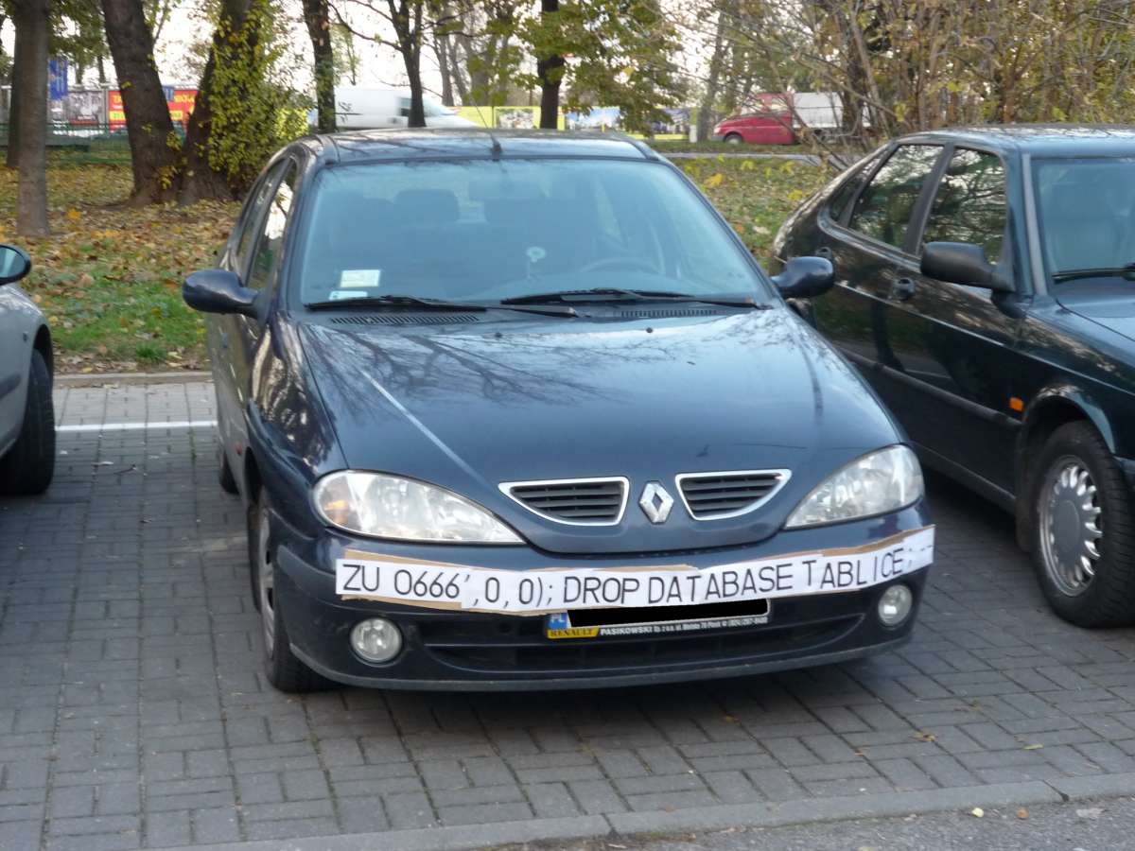

Slide 42
SQL Injection
This is a much larger topic with lots of info out there
SQL Server is better than some RDBMS platforms but is in no way immune to SQL Injection made possible by security-ignorant development
Very important developers are aware of SQL Injection-blocking patterns with text fields on public websites:
Parameterize the input from the website (use sprocs!)
Sanitize inputs of special characters
Don’t run websites logins with more databases permission than needed (again, use sprocs!)

Slide 43
SQL Injection
As a DBA, what can you do to prevent SQL Injection?
Design tables with appropriate data types and lengths
Insist on stored procedures for public-facing operations like searches. Be aware of what is public-facing.
Insist on stored procedures for Entity Framework (or other ORMs) operations involving 2+ entities (also a good performance idea)
For user-interactive service accounts, avoid database-wide permissions such as the database roles like db_datareader and db_datawriter
Avoid the use of EXECUTE AS in code, which could allow injected code to execute with elevated security

Slide 44
SQL Injection
As a DBA, what can you do to prevent SQL Injection?
Train developers on basic patterns of stored procedure parameter sanitizing
Provide links, attention, and visibility to PM’s and Dev’s for SQL Injection awareness
Lobby for penetration testing and SQL Injection detection tasks in sprints
If using Azure SQL DB, enable Azure Threat Detection!

Slide 45
Aside on AZURE threat detection
Azure SQL Database Threat Detection is a security intelligence feature built into the Azure SQL Database, activated with a button click.
Detects potential vulnerabilities such as Potential SQL Injection attacks, brute force attacks, anomalous login patterns, and more, and then emails you with the details.

Slide 46
Stored procedures
Stored procedures require EXECUTE to run, and do not require all underlying object permissions (SELECT, INSERT, DELETE)…
…provided that the sproc doesn’t perform IDENTITY_INSERT on a table, which requires ALTER permissions not abstracted.
…provided that all the underlying objects have the same ownership chain.
…provided that the stored procedures do not use dynamic sql commands exec sp_executesql @SQL or EXEC(@SQL)

Slide 47
Stored procedures
Given those conditions, thanks to the database permission chain, you can
GRANT EXEC rights to sprocs that INSERT UPDATE and SELECT from a table.
GRANT no other permissions to the table!
The user can read data in the table using the sproc ONLY.

Slide 48
Stored procedures
Consider DENYing SELECT rights to the public role, which is inherited by all user roles aside from db_owner and sysadmin.
Users will be prevented from accessing any tables or views directly, from any application (SSMS, Access, Excel!).
User access to data is forced through your stored procedures.

Slide 49
Views
Similar to stored procedures, a VIEW will allow a user to SELECT data from tables that the user does not have access to.
Views are provisioned similarly to Tables and can even be writeable (UPDATE, INSERT, DELETE) in the following conditions:
The view references only a single table.
No aggregations, UNION, distinct, GROUP, TOP
In this way, views can be used to expose a vertically-partitioned version of a table.

Slide 50
User-Defined Functions (UDF)
Similar to stored procedures, a UDF will allow a user to SELECT data from tables that the user does not have access to.
Keep in mind the performance impact of functions can be severe, especially in the SELECT portion of a query.
Overuse of UDF’s are common causes for performance issues. High potential for cursor-like effects.

Slide 51
lab
Demonstrate how Stored Procedures, Views, and Functions abstract the permissions necessary to view underlying table data.
Toolbox\Security p1.sql – logged in as sysadmin
Toolbox\Security p2.sql – logged in as testing user

Slide 52


And now for Something
completely different

Slide 53
Builtin\administrators
Prior to SQL 2008, [BUILTIN\Administrators] was a member of the SQL sysadmin role.
This was a security hole – allowing anyone who gained admin access to a Windows Server to automatically and easily have sysadmin access.
SQL 2008 – BUILTIN\Administrators no longer have automatic rights to the SQL server and should NOT be granted access.

Slide 54
dbo
In SQL 2000, sales.dbo.customers meant:
databasename = sales
owner = dbo
tablename = customers
In 2005 and later, sales.dbo.customers meant:
databasename = sales
schema = dbo
tablename = customers

Slide 55
dbo
In SQL 2000, dbo was a special user inside each database with sysadmin permissions, which by default owned any object created by an admin. The dbo user could not be deleted.
In SQL 2005 and above, dbo is the default schema and no longer a security object. Saying a user has “dbo permissions” is incorrect.
[db_owner] is just a user role with no server-level permissions.

Slide 56
ownership
Microsoft has done away with the terminology of Users or Logins “owning” objects, such as databases and schemas.
Changing the AUTHORIZATION is now the more accurate term to describe “ownership” of an object.
For example, sp_changedbowner is deprecated, replaced by
ALTER AUTHORIZATION

Slide 57
Schemas
A schema is a securable container
It contains database of objects, by default objects are inside the internal “dbo” schema.
Additional user schemas can be created. Permissions can be granted to schemas as a set.
Examples:
logical [Staging], [ODS], [Audit], [WH]
business [Sales], [HR], [Acct], [Inv]

Slide 58
schemas
Schemas can have owners and permissions to schemas can be granted to database principals.
For example:
CREATE SCHEMA [STAGING] AUTHORIZATION [ETLAdminUser];
CREATE TABLE [STAGING].[AuditLog] (…);
GRANT SELECT ON [STAGING] TO [ETLReadOnlyUser];

Slide 59
PUBLIC
Every login and user is a member of “public”.
Public is a server role that should never be granted any additional permissions, authorization or ownership.
Every database user/roles belongs to a public database role.
When a user has not been granted or denied specific permissions on a securable, the user inherits the permissions granted to public.

Slide 60
PUBLIC
Check for this.
Toolbox: public permissions.sql
Permissions assigned to the public role is a clear sign of lazy developers.
There are software vendors who have used public to easily grant access to all current and future logins. Watch out for this.
The strategy to undo a security architecture based around public is actually pretty complicated, involves lots of testing.

Slide 61
GUEST
Check for this.
Toolbox: guest permissions.sql
The GUEST account permissions are granted to any login who does not have a mapped user in the database.
For what should be very obvious reasons, never grant any permissions, even CONNECT, to GUEST, unless you understand what you’re doing.
Not a secure solution for future access.

Slide 62
Cross database ownership
A sproc/view can return data from a table in another database without permissions, if the two databases share the same owner login, by enabling Cross-Database Ownership Chaining on both databases.
This is not enabled by default on user databases. It has to be enabled at the server level then activated in each database…

Slide 63
Cross database ownership
Any login can take advantage of Cross-Database Ownership Chaining from another database.
Stored procedures and views – not queries - can then query other databases without any additional permissions.
Which could be very helpful, or a security risk…

Slide 64
Cross database ownership
It is possible that cross-database ownership can bypass your permissions by querying from the context of another database!
Enabling Cross-Database Ownership Chaining increases the necessary complexity of securing your data with minimum permissions.
You don’t need it, do it right.

Slide 65
Application roles
By executing sp_setapprole, an application can give a user connection the permissions of an app role.
The application role has no permanent members, but is assigned permissions and given a app-only password.
The user connection assumes only the permissions of the application role.
You can utilize Active Directory-based Windows authentication without DB permissions for those logins
Cons:
Accessing other databases requires the use of the guest role.
Connection pooling can be problematic (cookies)

Slide 66
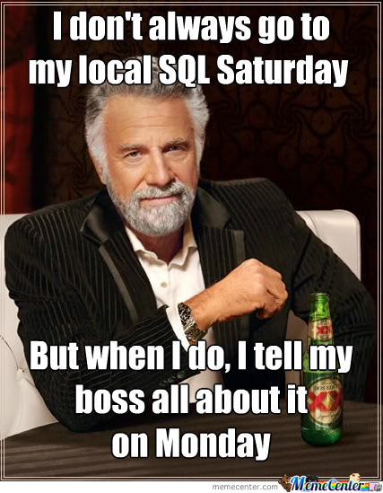

Slide 67
Continued reading
http://msdn.microsoft.com/en-us/library/ms191291.aspx
https://docs.microsoft.com/en-us/sql/connect/oledb/oledb-driver-for-sql-server?view=sql-server-2017
https://blogs.msdn.microsoft.com/sqlnativeclient/2017/10/06/announcing-the-new-release-of-ole-db-driver-for-sql-server/
https://techcommunity.microsoft.com/t5/SQL-Server/ODBC-Driver-17-for-SQL-Server-Released/ba-p/385825
http://social.technet.microsoft.com/wiki/cfs-file.ashx/__key/communityserver-wikis-components-files/00-00-00-00-05/5710.Permissions_5F00_Poster_5F00_2008_5F00_R2_5F00_Wiki.pdf
http://msdn.microsoft.com/en-us/library/bb669058(v=VS.110).aspx
http://blogs.msdn.com/b/sqlsecurity/archive/2011/08/25/database-engine-permission-basics.aspx
http://msdn.microsoft.com/en-us/library/ms191465.aspx
https://docs.microsoft.com/en-us/sql/relational-databases/databases/security-best-practices-with-contained-databases?view=sql-server-2017
https://azure.microsoft.com/en-us/blog/azure-sql-database-threat-detection-your-built-in-security-expert/
https://www.slideshare.net/GrantFritchey/sql-injection-what-it-is-how-to-stop-it
http://technet.microsoft.com/en-us/library/ms187359.aspx
http://support.microsoft.com/kb/918992
https://azure.microsoft.com/en-us/documentation/articles/sql-database-aad-authentication/
https://azure.microsoft.com/en-us/documentation/articles/sql-database-manage-logins/

Slide 68
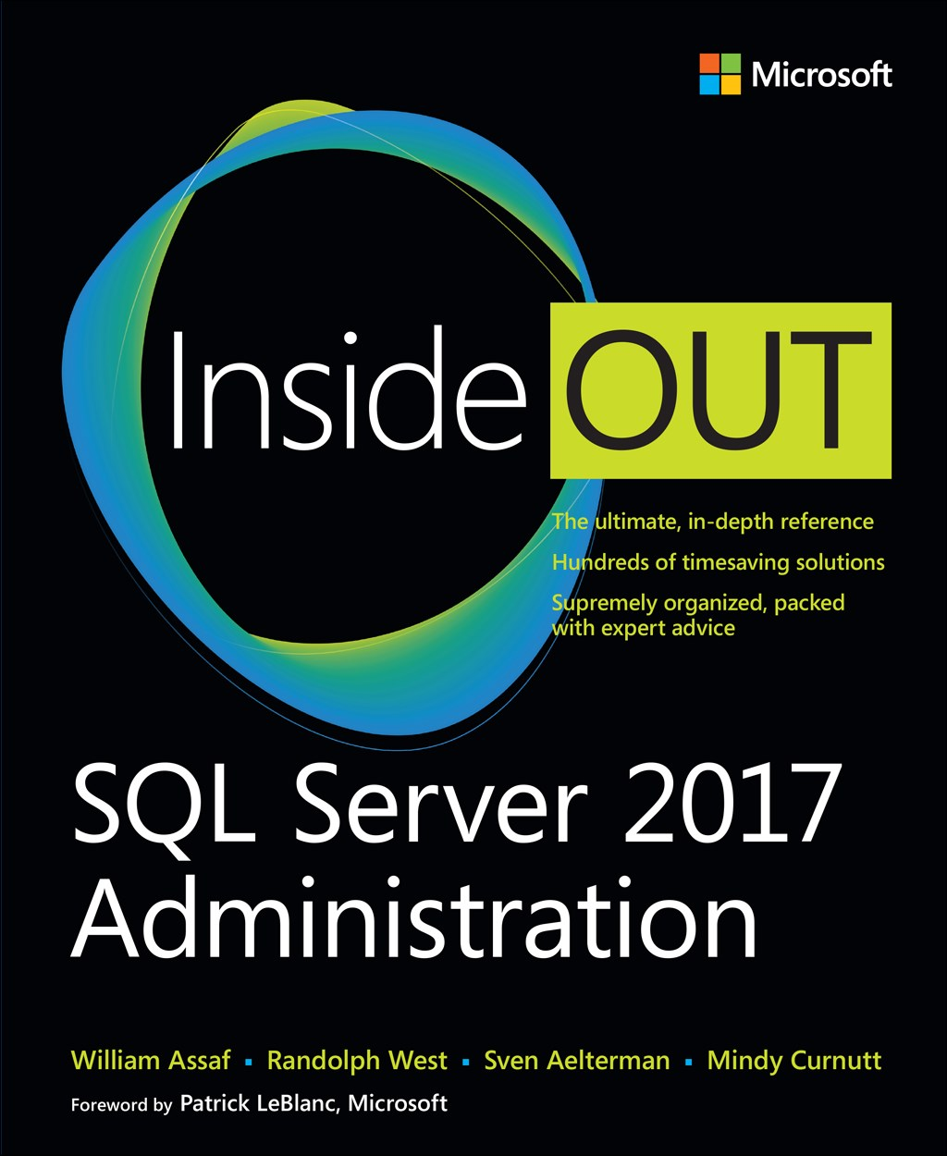
SQL Server 2017 Administration Inside Out
Published Feb 2018 by Microsoft Press
2nd edition for SQL 2019 coming Q4’2019*
*just a guess

Slide 69

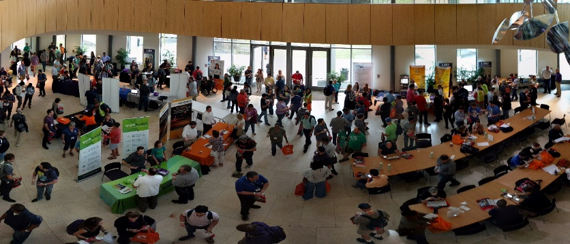



Free SQL Server, .NET, Business Intelligence training and more!
An all day FREE training event with SQL Server and Development related sessions spread out over multiple tracks of Business Intelligence, SQL Development,
Database Administration, IT Pro, .NET,
Career Development, and CIO/IT Management
See you August 17 at
SQLSatBR.com

Slide 70
Our Call for Speakers closes TONIGHT!
See you August 17 at
SQLSatBR.com

Slide 71

Bio and contact
William D Assaf, MCSE
Baton Rouge SQL Server UG board and SQLSat chair
Principal Consultant, Manager – DBA Team at
Sparkhound Inc.
William.Assaf@sparkhound.com
Twitter: @william_a_dba
This presentation, including all source code, available at my blog:
SQLTact.com

